Slide 1

Workplace Violence Prevention
for Nail Salon Workers and Owners
This material was produced under grant number SH-39155-SH2 from the Occupational Safety and Health Administration, U.S. Department of Labor. It does not necessarily reflect the views or policies of the U.S. Department of Labor, nor does mention of trade names, commercial products, or organizations imply endorsement by the U.S. Government.
Notes:
Welcome to our training today! Today you will be learning about workplace violence prevention for nail salons.

Slide 2
Khoá huấn luyện
Phòng Chống Bạo Lực
Tại Nơi Làm Việc
Cho nhân viên và chủ tiệm Nail
Tài liệu được phát hành dưới sự cho phép số SH-39155-SH2 từ Cơ quan Quản lý An toàn và Sức khỏe Nghề nghiệp, Bộ Lao động Hoa Kỳ. Nó không nhất thiết phản ánh quan điểm hoặc chính sách của Bộ Lao động Hoa Kỳ, cũng như không đề cập đến tên thương mại, sản phẩm thương mại hoặc tổ chức ngụ ý sự chứng thực của Chính phủ Hoa Kỳ.
Notes:
Welcome to our training today! Today you will be learning about workplace violence prevention for nail salons.

Slide 3

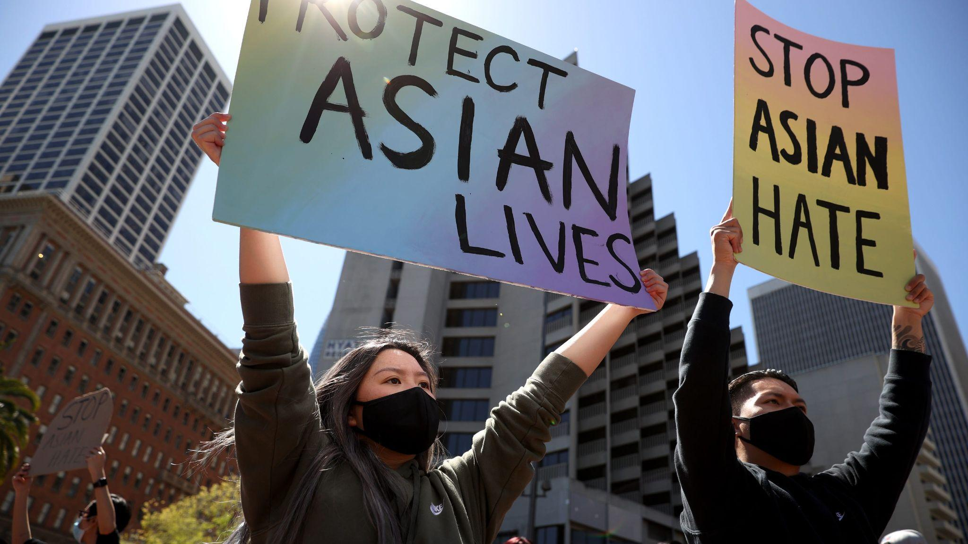
Why are we here today?
Rise in anti-Asian violence since the start of the pandemic
This has affected the nail salon community and manicurists are concerned about their safety
Goal: Understand what is needed to make a safety plan that salons can use
Notes:
In today’s training, we are going to focus on staying safe at work, with a focus on preventing workplace violence in nail salons.
This is important because we know there has been a rise in anti-Asian crimes since the start of the pandemic, and this has made folks in the nail salon community feel afraid. We want to walk you through this training, so you can be more proactive about preventing violence and handling a situation if it does happen.
Thanks for attending this training. It’s good for everyone in the salon to be aware of best practices.
At the end of today, we aim to set the groundwork for a safety plan that every salon can refer to.

Slide 4
Tại sao chúng ta ở đây hôm nay?
Bạo lực chống người châu Á gia tăng kể từ khi bắt đầu đại dịch
Điều này đã ảnh hưởng đến cộng đồng Nail và những thợ làm móng lo ngại về sự an toàn của họ
Mục tiêu: Hiểu những gì cần thiết để lập một kế hoạch an toàn mà các tiệm có thể áp dụng
Notes:
In today’s training, we are going to focus on staying safe at work, with a focus on preventing workplace violence in nail salons.
This is important because we know there has been a rise in anti-Asian crimes since the start of the pandemic, and this has made folks in the nail salon community feel afraid. We want to walk you through this training, so you can be more proactive about preventing violence and handling a situation if it does happen.
Thanks for attending this training. It’s good for everyone in the salon to be aware of best practices.
At the end of today, we aim to set the groundwork for a safety plan that every salon can refer to.

Slide 5
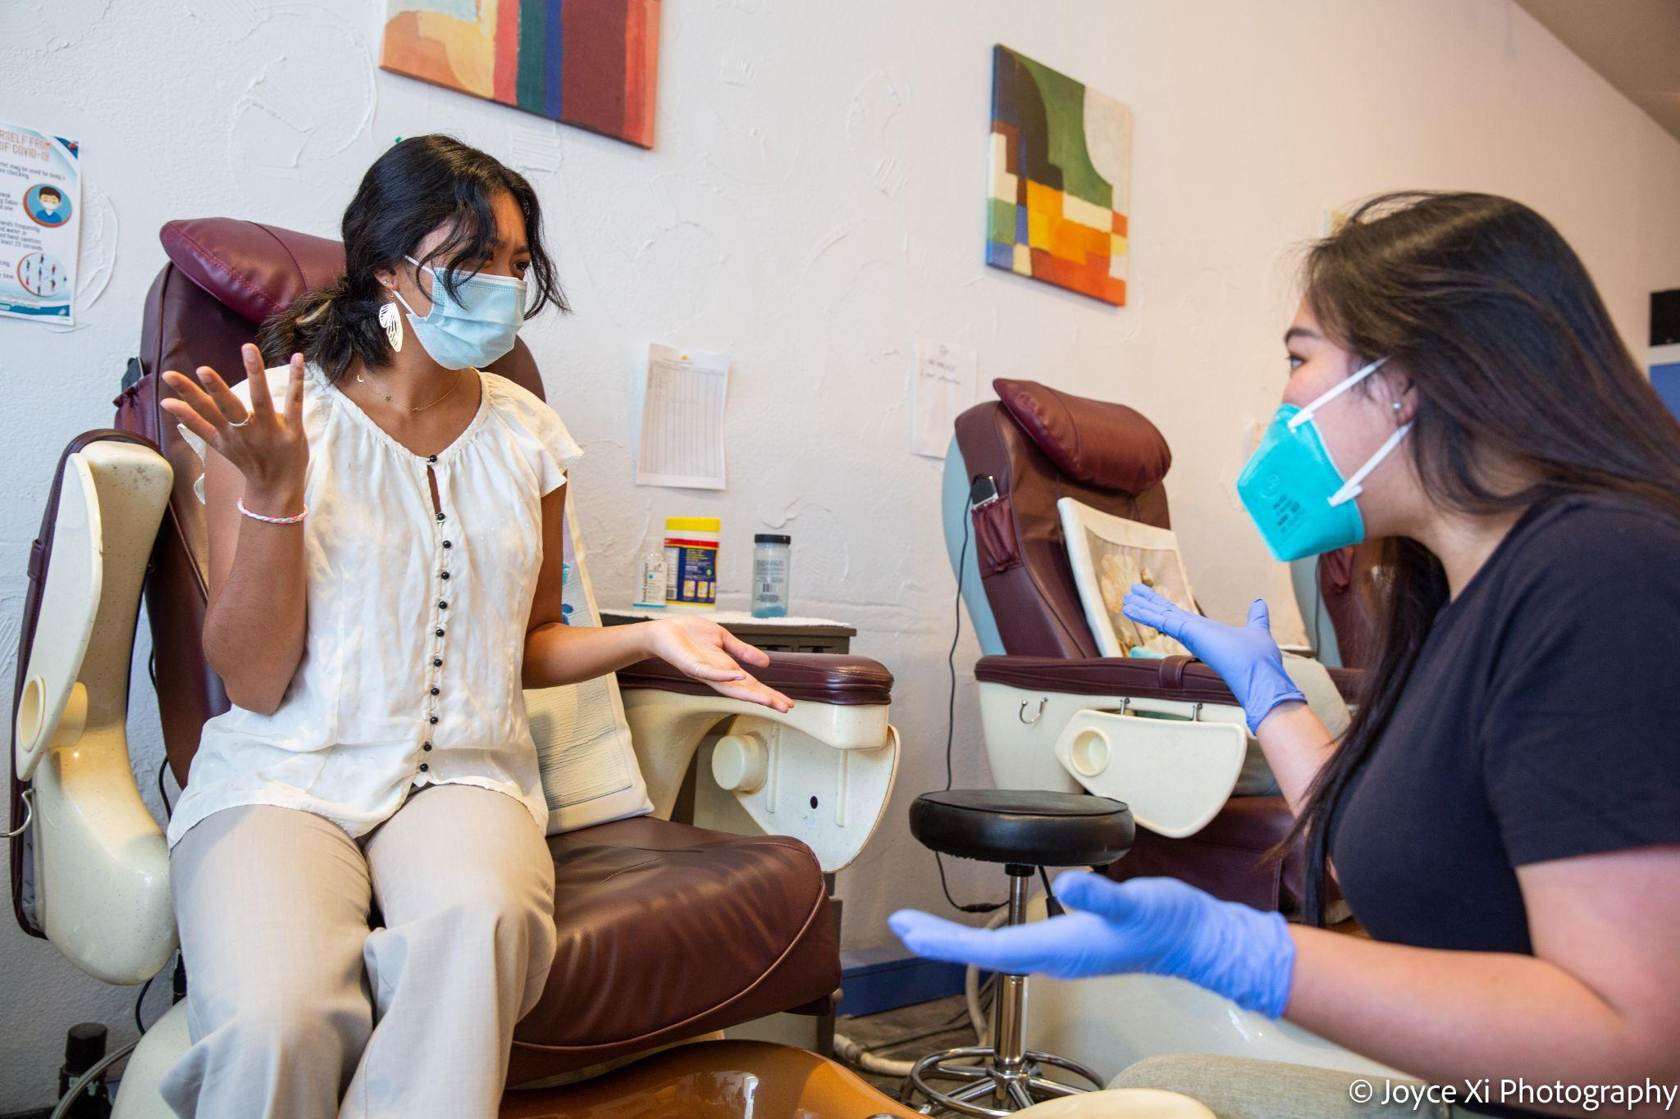
Recognizing the levels of violence
Level One (Anxiety/Tension)
Notes:
When controlling the hazards are not enough and a WPV incident starts to happen, it is important for workers and employers to know how to deescalate the situation before it gets worse.
In this next section, we will talk about recognizing different levels of violence and we will discuss what to do in response to the different scenarios. We will talk about four different levels. Employees must make a judgment call as to the appropriate action by evaluating the situation for themselves.
[Read or ask someone to read the description for Level One]

Slide 6
Nhận biết mức độ bạo lực
Cấp độ một (Lo lắng / Căng thẳng)
Notes:
When controlling the hazards are not enough and a WPV incident starts to happen, it is important for workers and employers to know how to deescalate the situation before it gets worse.
In this next section, we will talk about recognizing different levels of violence and we will discuss what to do in response to the different scenarios. We will talk about four different levels. Employees must make a judgment call as to the appropriate action by evaluating the situation for themselves.
[Read or ask someone to read the description for Level One]

Slide 7
Recognizing the levels of violence
Level One (Anxiety/Tension)
After giving a manicure to a customer, they go up to the register to pay and you tell them what the total cost is. You notice them frowning and tensing up. They say, “That’s more expensive than I thought it would be. I wouldn’t have gotten the nail art if I knew it cost that much.”
How would you respond to this situation?
Notes:
[Read the case study activity]
ASK: How would you respond to this situation?
[Answers may include: apologizing, referring to a sign where the prices are listed, being empathetic and explaining that the cost of supplies have increased, providing eye contact, nodding and listening]

Slide 8
Nhận biết mức độ bạo lực
Cấp độ một (Lo lắng / Căng thẳng)
Sau khi làm móng cho khách hàng, họ lên quầy thanh toán và bạn cho họ biết tổng chi phí là bao nhiêu. Bạn nhận thấy họ cau mày và căng thẳng. Họ nói, “Cái đó đắt hơn tôi nghĩ. Tôi sẽ không vẽ móng nếu tôi biết rằng nó đắt như vậy ”.
Bạn sẽ ứng phó với tình huống này như thế nào?
Notes:
[Read the case study activity]
ASK: How would you respond to this situation?
[Answers may include: apologizing, referring to a sign where the prices are listed, being empathetic and explaining that the cost of supplies have increased, providing eye contact, nodding and listening]

Slide 9
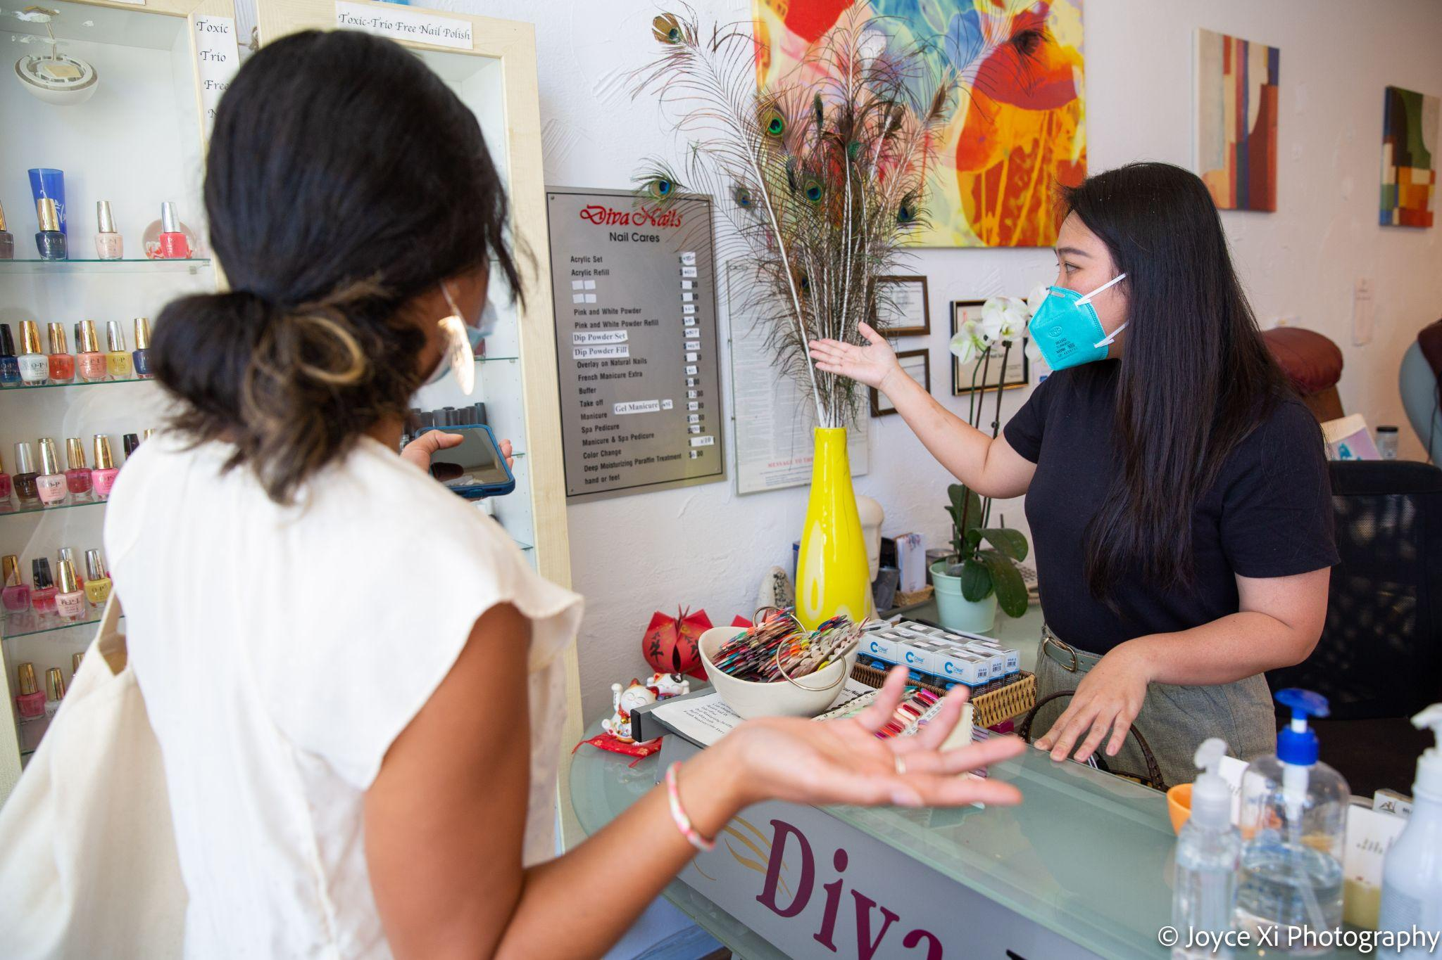
Recognizing the levels of violence
Level Two (Argumentative/Defensive)
Notes:
[Read or ask someone to read the description for Level Two]

Slide 10
Nhận biết mức độ bạo lực
Cấp độ hai (Tranh luận / Phòng thủ)
Notes:
[Read or ask someone to read the description for Level Two]

Slide 11
Recognizing the levels of violence
Level Two (Argumentative/Defensive)
The customer still seems upset after your response. They refuse to pay the full price of the service and say, “You Asian people could do nails for cheap.”
How would you respond to this situation?
Notes:
[Read the case study activity]
ASK: How would you respond to this situation?
[Answers may include: involving the manager or owner to help speak with the customer, giving short directions like “please lower your voice”, offer that they could go to another salon next time, suggest that the other customers are feeling uncomfortable, ask them to leave the store if they refuse to pay]

Slide 12
Nhận biết mức độ bạo lực
Cấp độ hai (Tranh luận / Phòng thủ)
Khách hàng vẫn có vẻ khó chịu sau câu trả lời của bạn. Họ từ chối thanh toán toàn bộ giá của dịch vụ và nói, "Người châu Á các bạn có thể làm móng với giá rẻ mà.“
Bạn sẽ ứng phó với tình huống này như thế nào?
Notes:
[Read the case study activity]
ASK: How would you respond to this situation?
[Answers may include: involving the manager or owner to help speak with the customer, giving short directions like “please lower your voice”, offer that they could go to another salon next time, suggest that the other customers are feeling uncomfortable, ask them to leave the store if they refuse to pay]

Slide 13
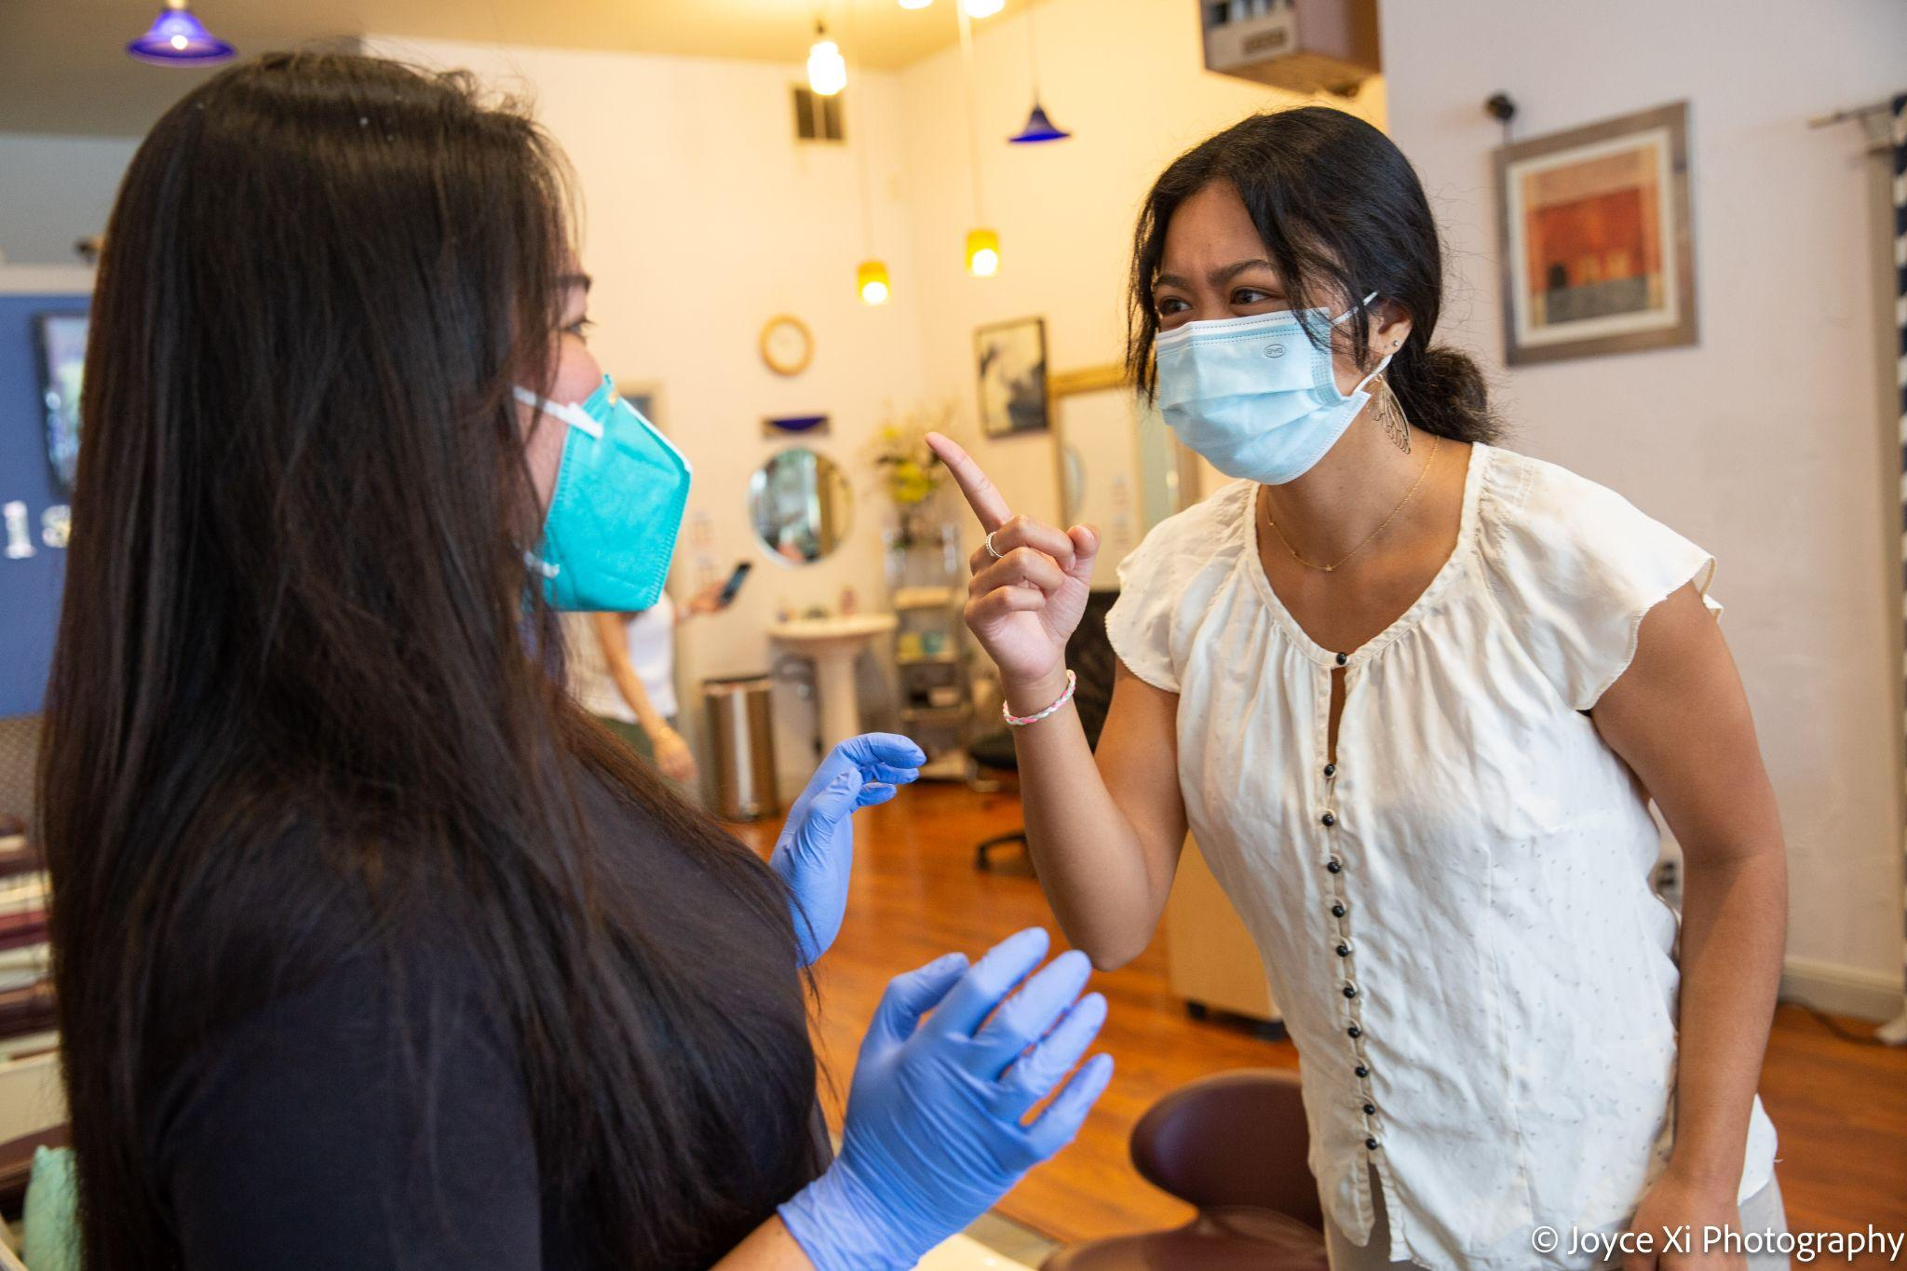
Recognizing the levels of violence
Level Three (Verbally/Physically Threatening)
Notes:
[Read or ask someone to read the description for Level Three]

Slide 14
Nhận biết mức độ bạo lực
Cấp độ ba (Đe dọa bằng lời nói / thể chất)
Notes:
[Read or ask someone to read the description for Level Three]

Slide 15
Recognizing the levels of violence
Level Three (Verbally/Physically Threatening)
The customer is still irrationally angry, even though you have asked them to leave the salon. They refuse to calm down and they start standing over the workers and yelling at them. They say they will come back and hurt the workers.
How would you respond to this situation?
Notes:
[Read the case study activity]
ASK: How would you respond to this situation?
[Answers may include: speaking slowly and clearly and asking the individual to leave the store, ask them to sit down; call 911 if they continue with threats; if they seem to be on substances, maybe refer them to substance help later; ask them what you can do to help them regain control; ask them why they want to commit violence and what they hope to gain; ask them if they need help or would like you to call someone; tell other workers to stay back]

Slide 16
Nhận biết mức độ bạo lực
Cấp độ ba (Đe dọa bằng lời nói / thể chất)
Khách hàng vẫn tức giận vô cớ, mặc dù bạn đã yêu cầu họ rời khỏi tiệm. Họ từ chối bình tĩnh và bắt đầu đứng trước người lao động và quát mắng họ. Họ nói rằng họ sẽ quay lại và làm tổn thương người lao động.
Bạn sẽ ứng phó với tình huống này như thế nào?
Notes:
[Read the case study activity]
ASK: How would you respond to this situation?
[Answers may include: speaking slowly and clearly and asking the individual to leave the store, ask them to sit down; call 911 if they continue with threats; if they seem to be on substances, maybe refer them to substance help later; ask them what you can do to help them regain control; ask them why they want to commit violence and what they hope to gain; ask them if they need help or would like you to call someone; tell other workers to stay back]

Slide 17
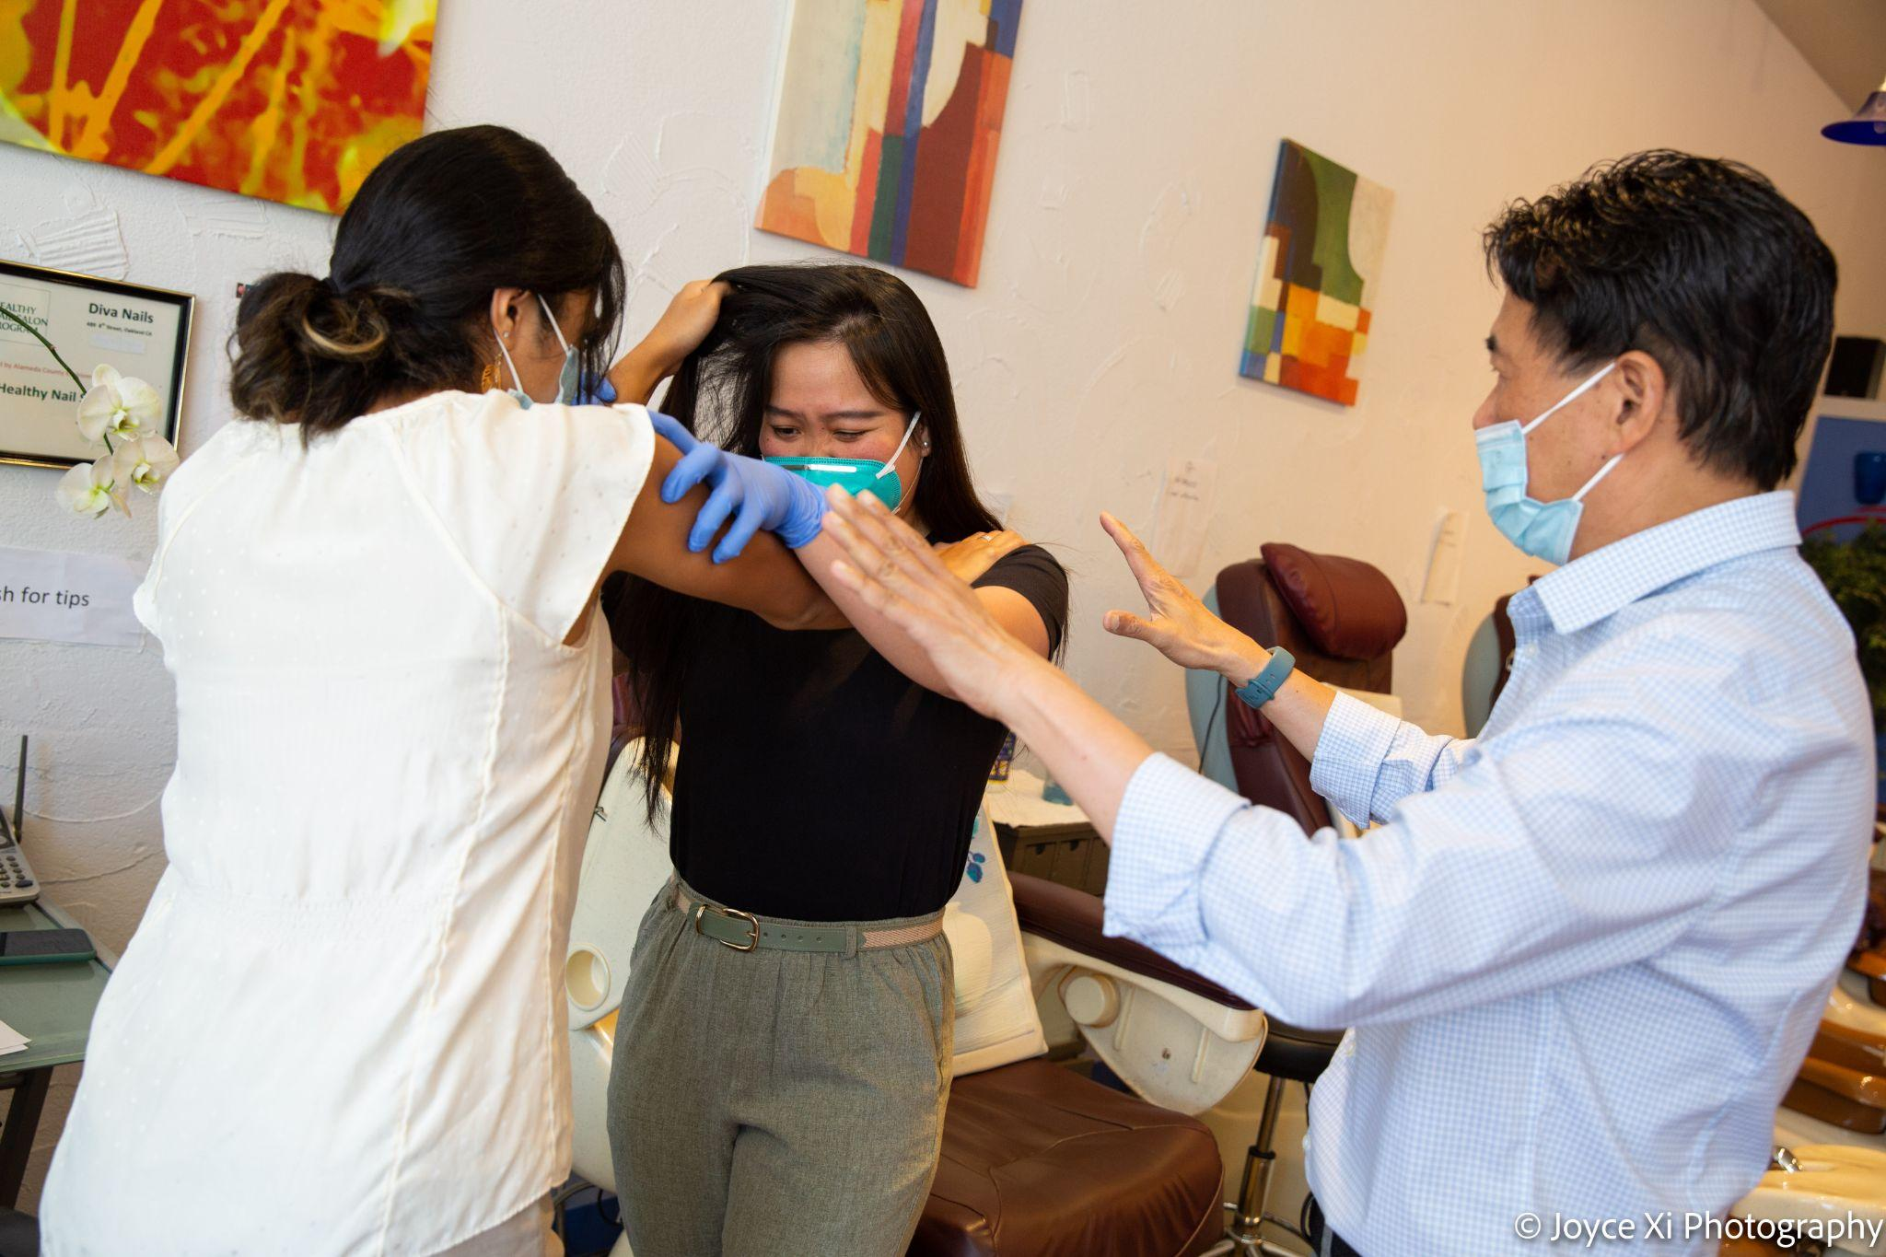
Recognizing the levels of violence
Level Four (Assaultive)
Notes:
[Read or ask someone to read the description for Level Four]

Slide 18
Nhận biết mức độ bạo lực
Cấp độ bốn (tấn công)
Notes:
[Read or ask someone to read the description for Level Four]

Slide 19
Recognizing the levels of violence
Level Four (Assaultive)
The customer refuses to listen and starts knocking over nail polish displays. A worker tries to stop them, but the customer pushes them over and starts punching them.
How would you respond to this situation?
Notes:
[Read the case study activity]
ASK: How would you respond to this situation?
[Answers may include: pull them off the person, ensure their own safety, designate one person to call 911, check for weapons and make sure they are unarmed (if armed, tell people to leave the store)]

Slide 20
Nhận biết mức độ bạo lực
Cấp độ bốn (tấn công)
Khách hàng từ chối lắng nghe và bắt đầu đập vào các quầy sơn móng tay. Một nhân viên cố gắng ngăn họ lại, nhưng khách hàng đẩy họ và bắt đầu đấm họ.
Bạn sẽ ứng phó với tình huống này như thế nào?
Notes:
[Read the case study activity]
ASK: How would you respond to this situation?
[Answers may include: pull them off the person, ensure their own safety, designate one person to call 911, check for weapons and make sure they are unarmed (if armed, tell people to leave the store)]

Slide 21
Reporting and Investigating Workplace Violence Incidents
Notes:
In the next section, we will discuss why is it important to report workplace violence and how to do so.

Slide 22
Báo cáo và điều tra các sự cố bạo lực tại nơi làm việc
Notes:
In the next section, we will discuss why is it important to report workplace violence and how to do so.

Slide 23
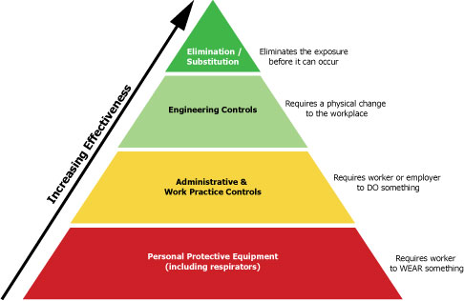
Safety pyramid
Notes:
Translator: we have a pyramid that is already translated, we can use it
In Handout F, we’ve included a Sample Workplace Security Profile in the handouts for you to fill out later with your salon. This can help provide an overview assessment of how secure your worksite is.
As we’ve discussed, improving workplace safety requires identifying the hazards and creating solutions. There are several ways to control a hazard, but some are better than others.
There are four layers to the pyramid.
At the top of the pyramid, we have elimination/substitution. The best control measures remove the hazard from the workplace altogether, or keep it isolated (away from workers), so it does not hurt anyone. This way, the workplace is safer and the responsibility for safety does not fall on individual workers. A familiar example is using safer nail salon chemicals instead of hazardous ones. For workplace violence, it can be difficult if not impossible to remove the hazard altogether. We will brainstorm possible strategies in the next section.
The next level is engineering controls. If you can’t completely eliminate a hazard or keep it away from workers, the next best practice is to change the physical layout of the workplace, so people are less likely to be harmed by the exposure. For example, if there is poor visibility in the salon, you could clear the front of the salon, so it is easier for outsiders to see inside. Another example is installing plexiglass between the cashier and the customer, so there is more of a physical barrier.
The next best step is administrative and work practice controls that change the behavior of workers and employers. This places more responsibility on the individual worker, so it can be less effective. One example would be ensuring that there are always at least 3 people in the salon at all times, so they can help each other in case something happens.
Last, personal protective equipment is the least effective way to control hazards because it puts all the responsibility on the worker, is not always reliable, and may not be convenient. Workers may not want to wear it because it can be uncomfortable and may make it hard to work. It may also have to fit properly and be used correctly. However, you should use it if it’s all you have. The main example that probably comes to mind right now is wearing masks to protect yourself from COVID-19. For workplace violence, this may include carrying whistles or pepper spray.

Slide 24
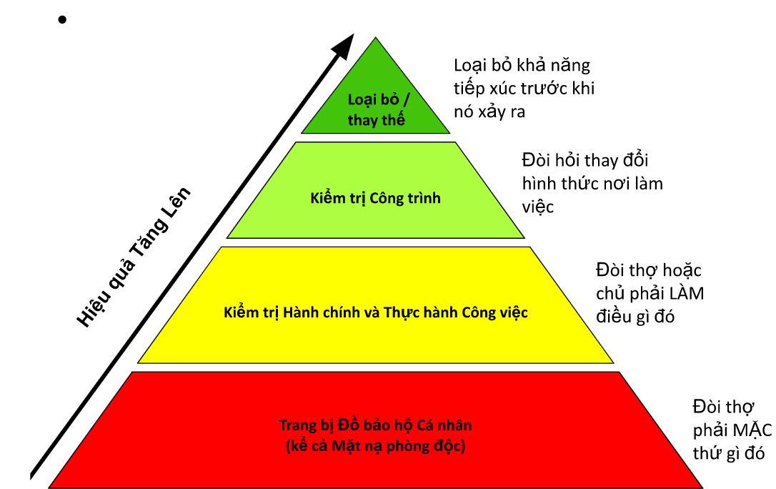
Kim tự tháp an toàn
Notes:
Translator: we have a pyramid that is already translated, we can use it
In Handout F, we’ve included a Sample Workplace Security Profile in the handouts for you to fill out later with your salon. This can help provide an overview assessment of how secure your worksite is.
As we’ve discussed, improving workplace safety requires identifying the hazards and creating solutions. There are several ways to control a hazard, but some are better than others.
There are four layers to the pyramid.
At the top of the pyramid, we have elimination/substitution. The best control measures remove the hazard from the workplace altogether, or keep it isolated (away from workers), so it does not hurt anyone. This way, the workplace is safer and the responsibility for safety does not fall on individual workers. A familiar example is using safer nail salon chemicals instead of hazardous ones. For workplace violence, it can be difficult if not impossible to remove the hazard altogether. We will brainstorm possible strategies in the next section.
The next level is engineering controls. If you can’t completely eliminate a hazard or keep it away from workers, the next best practice is to change the physical layout of the workplace, so people are less likely to be harmed by the exposure. For example, if there is poor visibility in the salon, you could clear the front of the salon, so it is easier for outsiders to see inside. Another example is installing plexiglass between the cashier and the customer, so there is more of a physical barrier.
The next best step is administrative and work practice controls that change the behavior of workers and employers. This places more responsibility on the individual worker, so it can be less effective. One example would be ensuring that there are always at least 3 people in the salon at all times, so they can help each other in case something happens.
Last, personal protective equipment is the least effective way to control hazards because it puts all the responsibility on the worker, is not always reliable, and may not be convenient. Workers may not want to wear it because it can be uncomfortable and may make it hard to work. It may also have to fit properly and be used correctly. However, you should use it if it’s all you have. The main example that probably comes to mind right now is wearing masks to protect yourself from COVID-19. For workplace violence, this may include carrying whistles or pepper spray.

Slide 25
Hazards Solutions
The customer isn’t happy with their service and they’re arguing with you about it.
Ask them what they aren’t happy with.
Ask another worker to redo their service.
The customer doesn’t want to pay for their service.
Ask them to leave, so the situation doesn’t escalate.
Offer them a discounted price.
Two workers are arguing.
Another worker or the employer should mediate.
Separate them, so they can calm down.
Two workers are physically fighting.
Separate them, so they can calm down.
The employer should interfere and find a solution.

Slide 26
Các mối nguy hiểm
Các giải pháp
Khách không hài lòng gây ra tranh cãi
Giải thích và hòa giải: giảm tiền cho khách
Đổi người phục vụ
Khách không muốn trả tiền
Cho khách đi để bảo đảm an toàn cho mình và các khách khác
Chụp hình để làm bằng chứng, từ chối phục vụ lần sau
Nhân viên trong tiệm tranh cãi
Ngồi xuống nói chuyện, cùng chủ và nhân viên giải hòa
Giữ im lặng để tình huống hạ nhiệt, sẽ giải quyết sau khi 2 người đã bình tĩnh
Nhân viên tiệm xung đột bạo lực
Can ngăn, cất những dụng cụ có thể gây tổn thương khỏi tầm nhìn
Chủ tiệm phải tìm cách giải quyết (loại bỏ nguy cơ gây ra bạo lực)

